Slide 1
A Formaldehyde Deuteration Survey of Dense Starless Cores in Taurus
Hanga Andras-Letanovszky
Mentor: Yancy Shirley, University of Arizona Department of Astronomy / Steward Observatory
Arizona Space Grant Symposium, University of Arizona, April 20, 2024

Slide 2
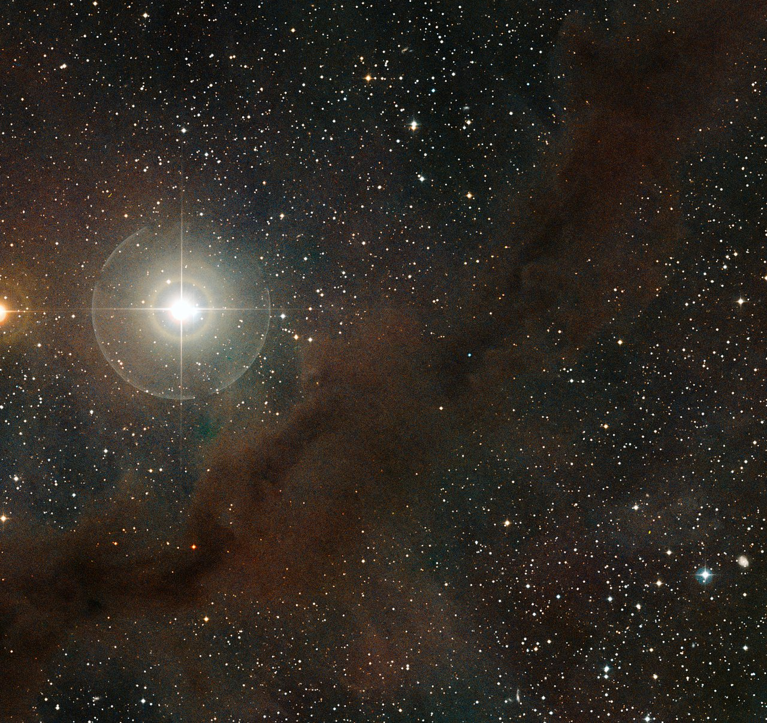
Starless Cores
Dense, cold clumps of gas and dust
  A few Kelvin above 2.73 K (Cosmic Microwave Background)
  In large molecular clouds
Can eventually gravitationally collapse into a protostar
  Determines the initial conditions for planet-forming disk
Core evolution isn’t well understood
Image Credit: European Southern Observatory

Slide 3
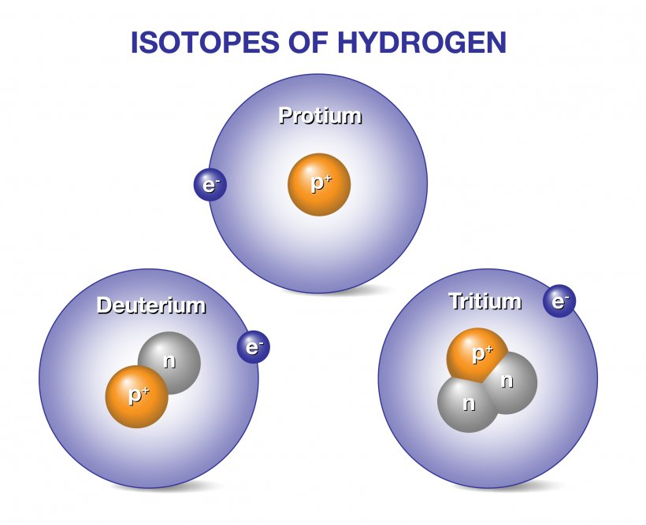
Deuteration
Hydrogen isotope with an extra neutron
Sometimes a regular hydrogen gets replaced with a deuterium atom in the molecule
This process occurs more frequently in cold, dense environments
Occurs either on icy grain surfaces or in the gas phase
Image Credit: General Atomics

Slide 4
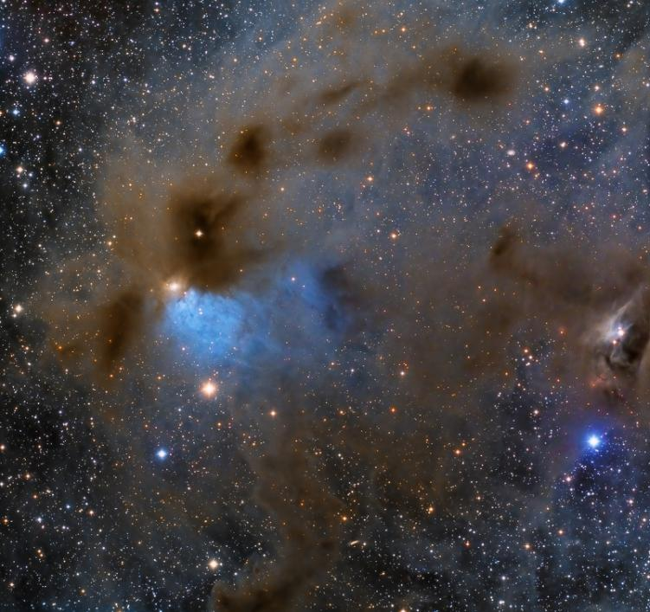
Deuteration
Deuterated molecules build up in starless cores over time
  Older cores tend to have higher ratios of deuterated to nondeuterated molecules
Can compare deuteration ratios to core densities to get a relative estimate of core age
  Better understand core evolution rates and thus star formation
Image Credit: Lloyd L. Smith, Deep Sky West

Slide 5
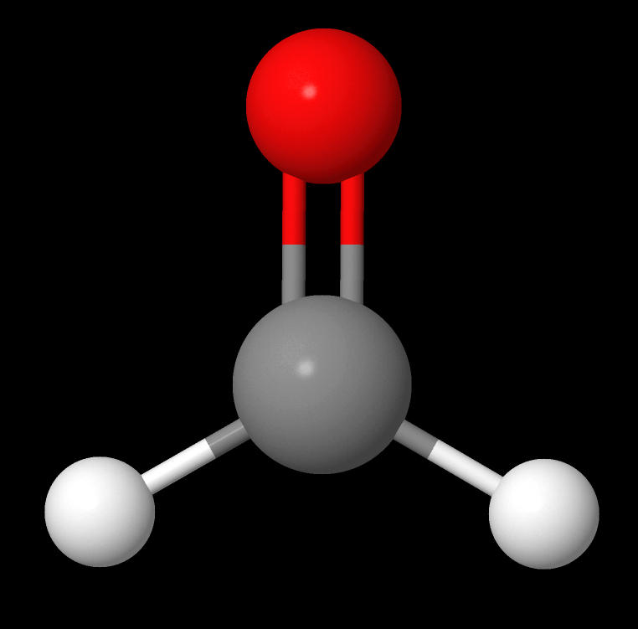
Objective
Core Peak Positions in 1.2mm Continuum Emission of B10
Get ratios of HDCO/oH₂CO (formaldehyde) of 11 cores in the Barnard 10 (B10) region of the Taurus Molecular Cloud
  H₂CO thought to deuterate primarily on icy grain surfaces
Estimate their ages, compare to chemical models to get evolution rates
Compare properties to find interesting trends
Image Credit: Seo et al. 2015
Image Credit: Kinetic Database for Astrochemistry

Slide 6
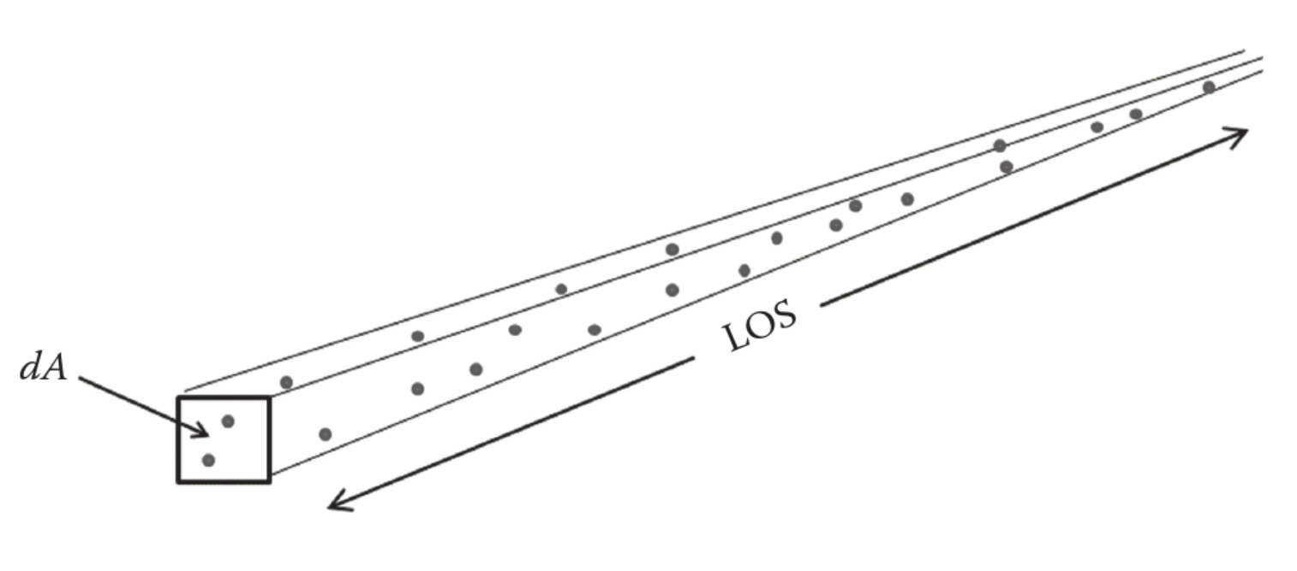
Methodology
We want column densities (N) and excitation temperatures (T_{ex}) for both
Column density is how many molecules there are in volume collapsed into an area
  Use instead of volume density because can’t get full 3D structure of cores easily
Excitation temperature is the temperature that describes the quantum energy level distribution of the molecules
Column Density
2D patch of sky
(line of sight)
Image Credit: Terahertz Astronomy by Christopher Walker

Slide 7
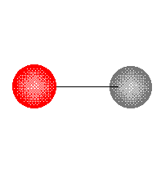
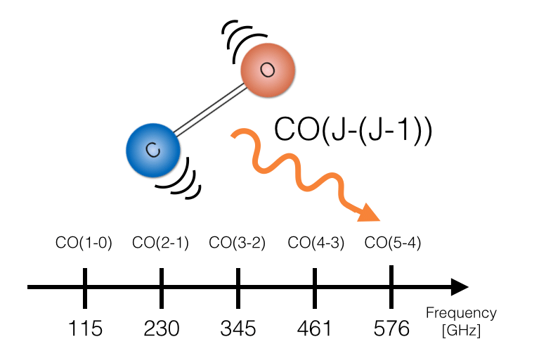
Methodology
photon
We’re looking at emission lines for rotational transitions of both molecules
  Molecules have specific ways they rotate determined by quantum mechanics
  When a molecule changes its rotational state, it emits a photon with energy equal to the change in energy of the molecule
  We detect these photons and make a spectrum of them
GIF Credit: https://www.andrew.cmu.edu/course/09-105/RotationalSpectra.html
Image Credit: Karen Olson

Slide 8
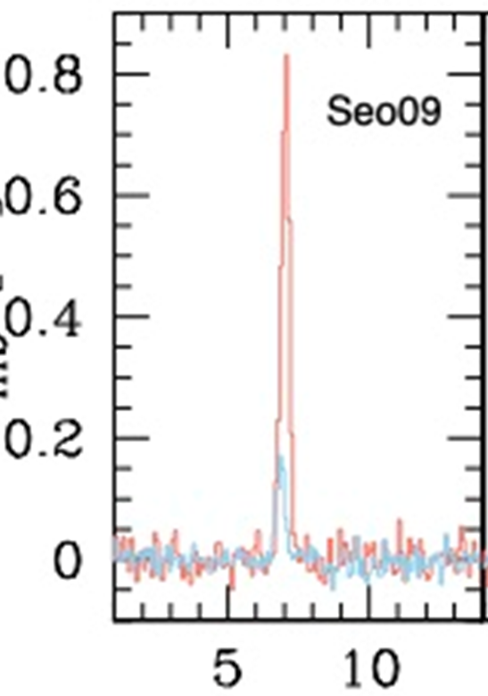
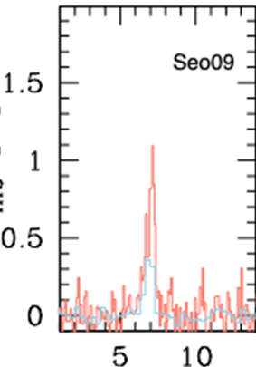
Methodology
Emission Lines for Seo09
Started with previously taken spectra of the 128 GHz and 134 GHz rotational transitions of HDCO
Used a map of B10 in the 140 GHz rotational transition of oH₂CO
  Originally had 225 GHz transition as well, but was too low resolution to use
Detected all 11 cores in all transitions
HDCO 128 GHz (orange) and 134 GHz (blue)
oH₂CO 140 GHz (orange) and 225 GHz (blue)
Intensity (K)
Velocity Offset (km/s)
Data taken at the 12m Radio Telescope on Kitt Peak!

Slide 9

Methodology - HDCO
Got N(HDCO) and T_{ex} of HDCO for each core
  Optically thin, so could directly compare curves for both lines using the CTEX method, which assumes both transitions have the same T_{ex}
  Curves directly proportional to intensity of transition
  Intersection of curves gave N(HDCO), T_{ex}, and errors
T_{ex} > Kinetic Temperature of Gas
HDCO Column Density (10¹¹ cm⁻²)
Excitation Temperature (K)
Notes:
Optically thin = photon emitted by HDCO molecule has high chance of making it to observer without another HDCO molecule absorbing it

Slide 10
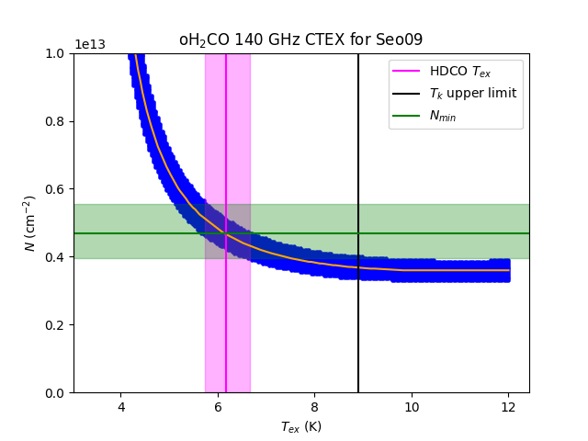
Methodology – H₂CO
oH₂CO is optically thick, so determining N(oH₂CO) and T_{ex} is less straightforward than for HDCO
Used CTEX with the T_{ex} values derived for HDCO
  Generated curves using own Python code and 140 GHz intensities
H₂CO Column Density (cm⁻²)
Seo09
Excitation Temperature (K)

Slide 11
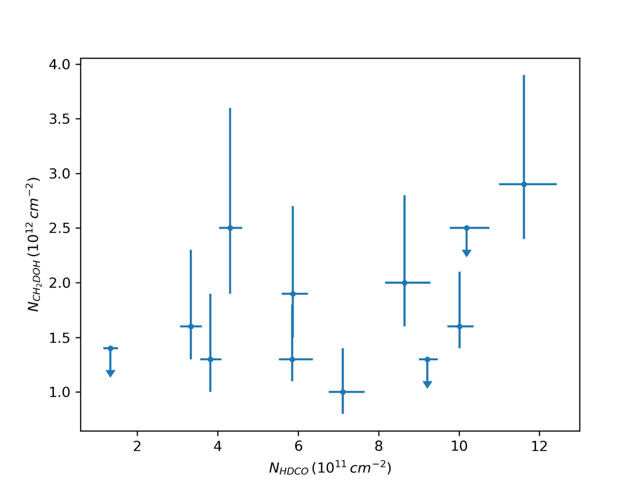
Results
Graph of HDCO vs CH₂DOH column density, no significant correlation
Strange because both molecules thought to deuterate on icy grain surfaces
Indicates that H₂CO deuteration may have a gas phase contribution
CH₂DOH Column Density (10¹² cm⁻²)
HDCO Column Density (10¹¹ cm⁻²)

Slide 12
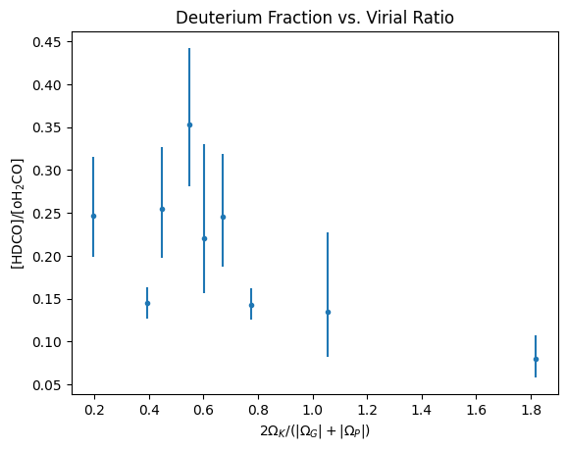
Results
Successfully determined HDCO/oH₂CO abundance ratios for each core
Found a significant anticorrelation with the virial ratio
Indicates that on average, more bound cores (i.e. cores that are more squeezed in by their own gravity and external pressure) have higher deuteration ratios
Deuterium Fraction
More Bound
Less Bound
(Virial Ratio)

Slide 13
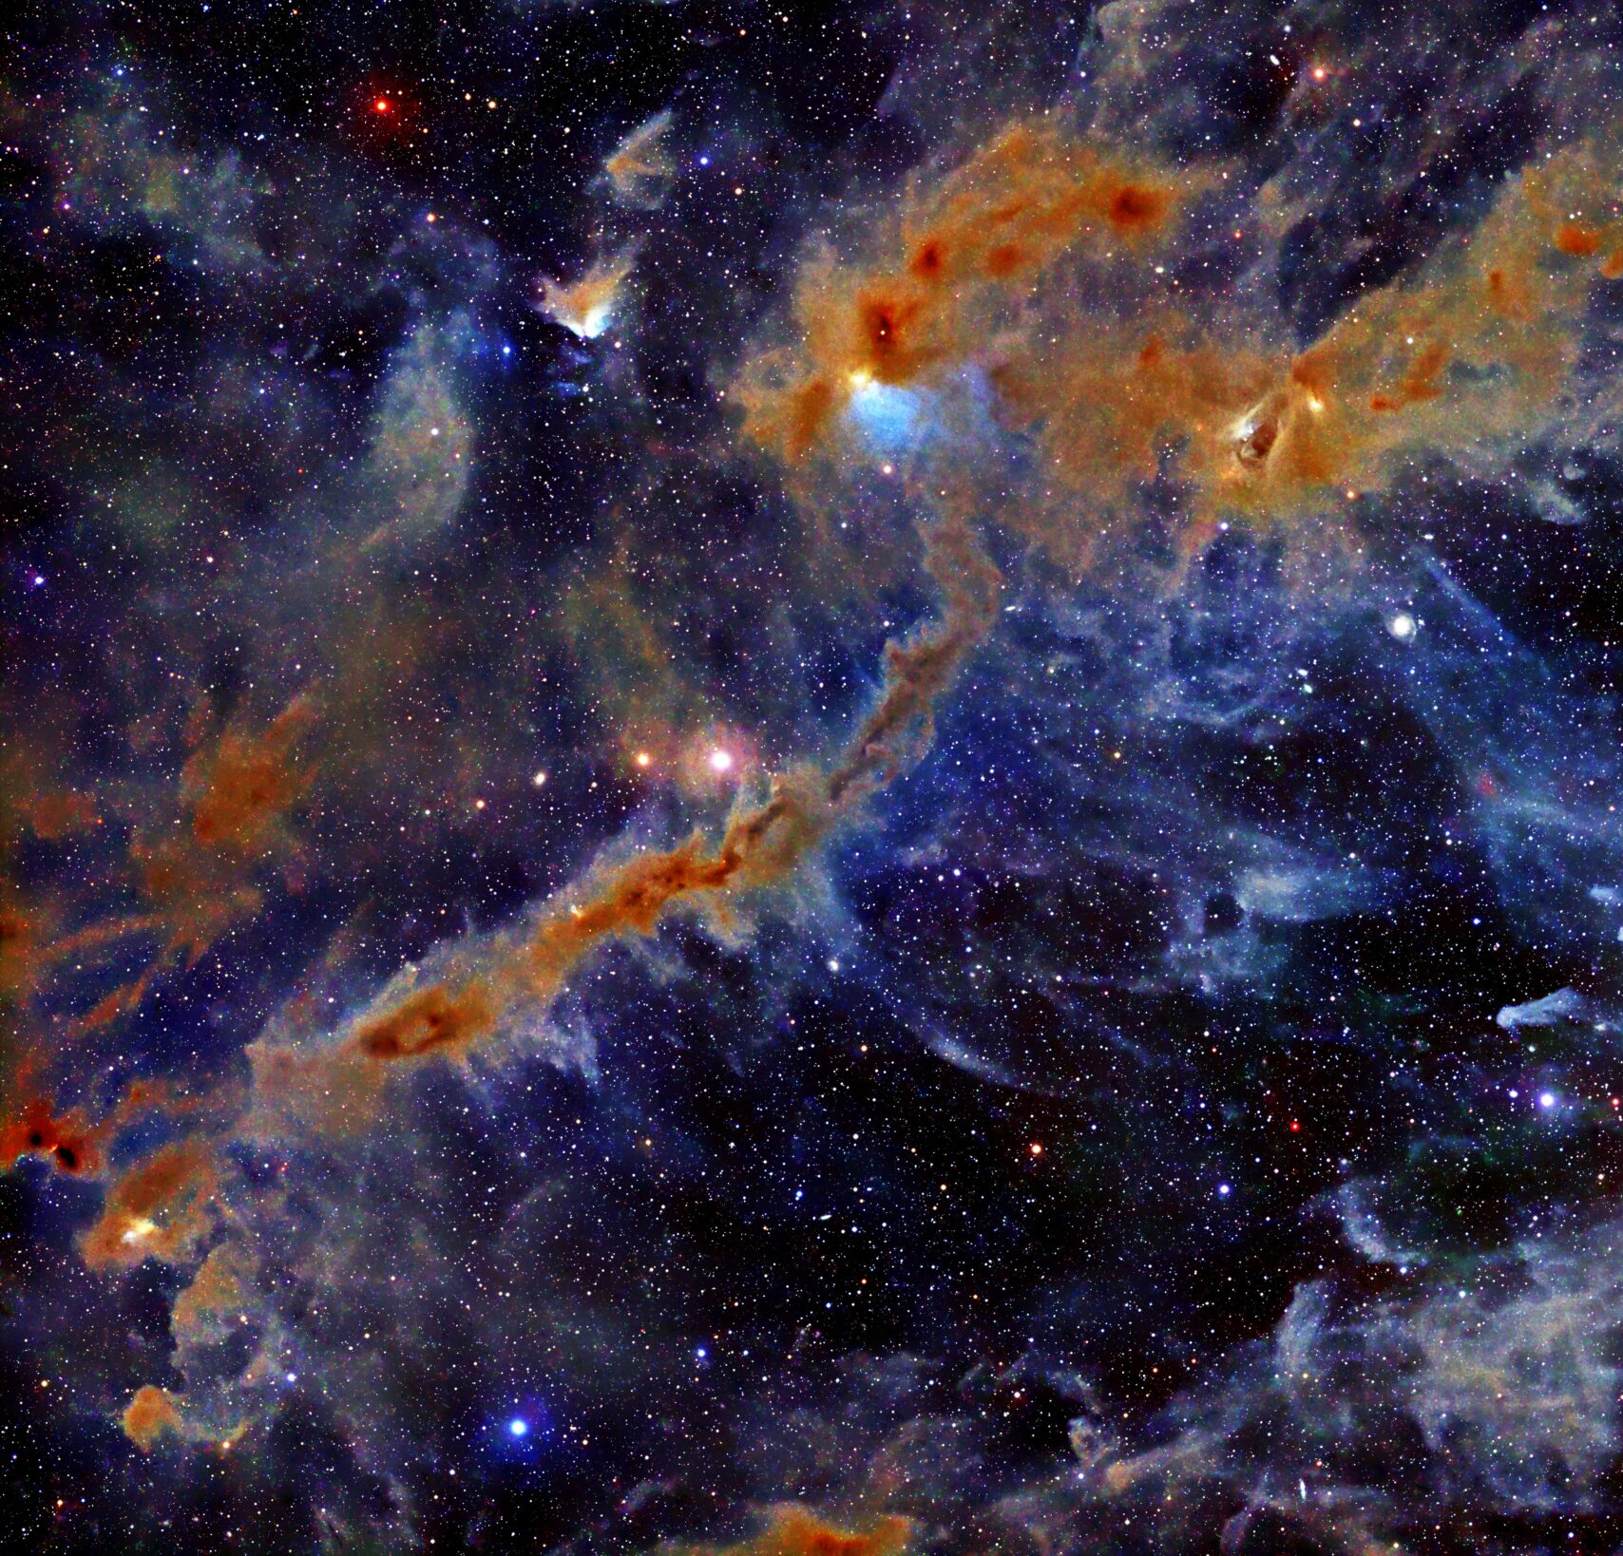
Next Steps
We will repeat this analysis for D₂CO for all 11 cores
  Further test of whether H₂CO deuteration correlates well with CH₃OH deuteration
We’ll also continue comparing the deuteration ratios to other physical and chemical properties of the cores
I’ll spend the next year writing a first author paper on my work
Image Credit: Stefan Ziegenbalg, Baader Planetarium

Slide 14
Acknowledgements
Dr. Yancy Shirley, University of Arizona Department of Astronomy / Steward Observatory
Dr. Samantha Scibelli, National Radio Astronomy Observatory
Michelle Coe & Dr. Chandra Holifield Collins, Arizona Space Grant Consortium
Nicholas Mazziotti & Walter Rahmer, Arizona Space Grant Consortium
Arizona Space Grant Consortium
NASA
The University of Arizona
Arizona Radio Observatory

Slide 15
Thank you!

Slide 16
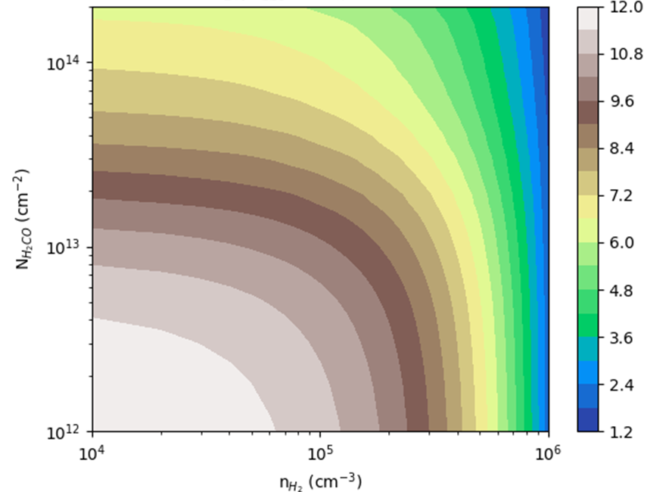
RADEX
H₂CO Line Intensity Ratio as a function of H2 Density and H₂CO Column Density
Initially tried simulating the interactions of the molecules with light and radiation in the cloud using RADEX software
  Failed because N(H₂CO) was too dependent on the H₂ density, which we don’t know
H₂CO Column Density (cm⁻²)
H₂ Density

